Slide 1

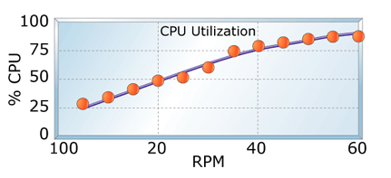
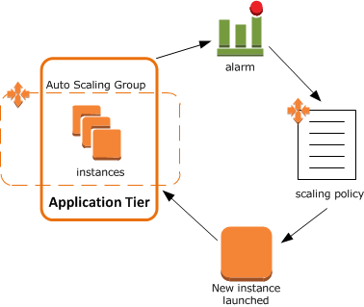
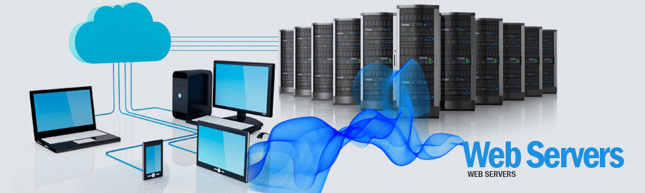
AWS
More Requests are hitting on a web page
Load Balancer URL
C.P.U load increases
Then automatic allocation
Of web servers
Web page
Auto Scaling and cloud watch triggers based on alarms
Web servers are created under the same load balancer

